Slide 1
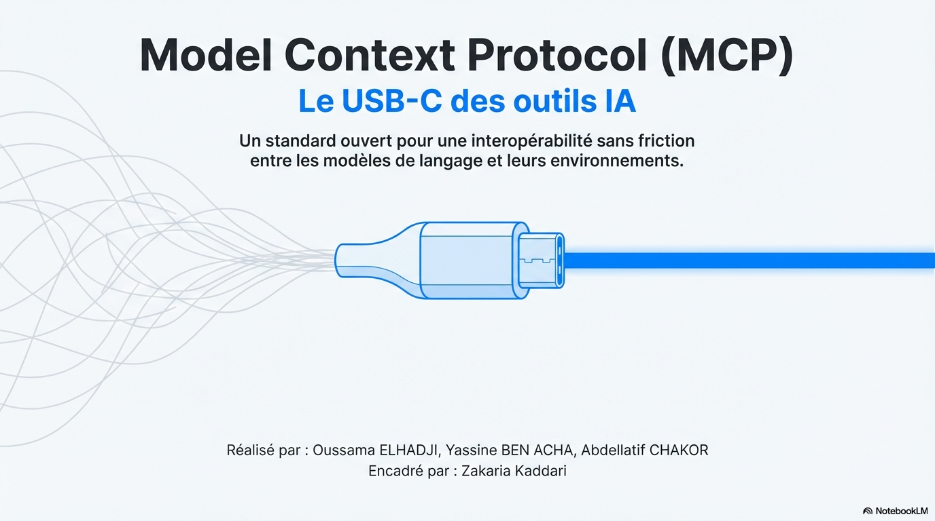

Page 1

Slide 2
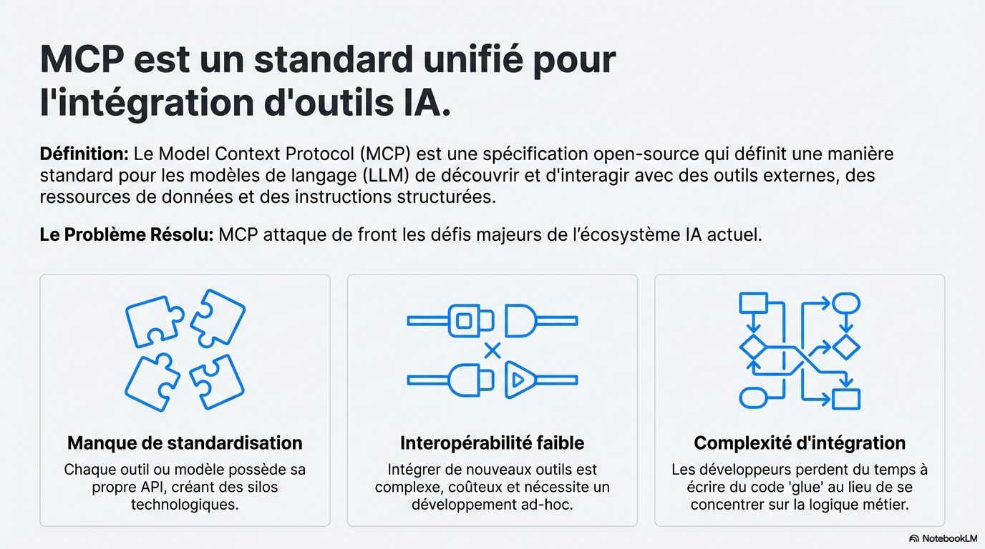
Page 2

Slide 3
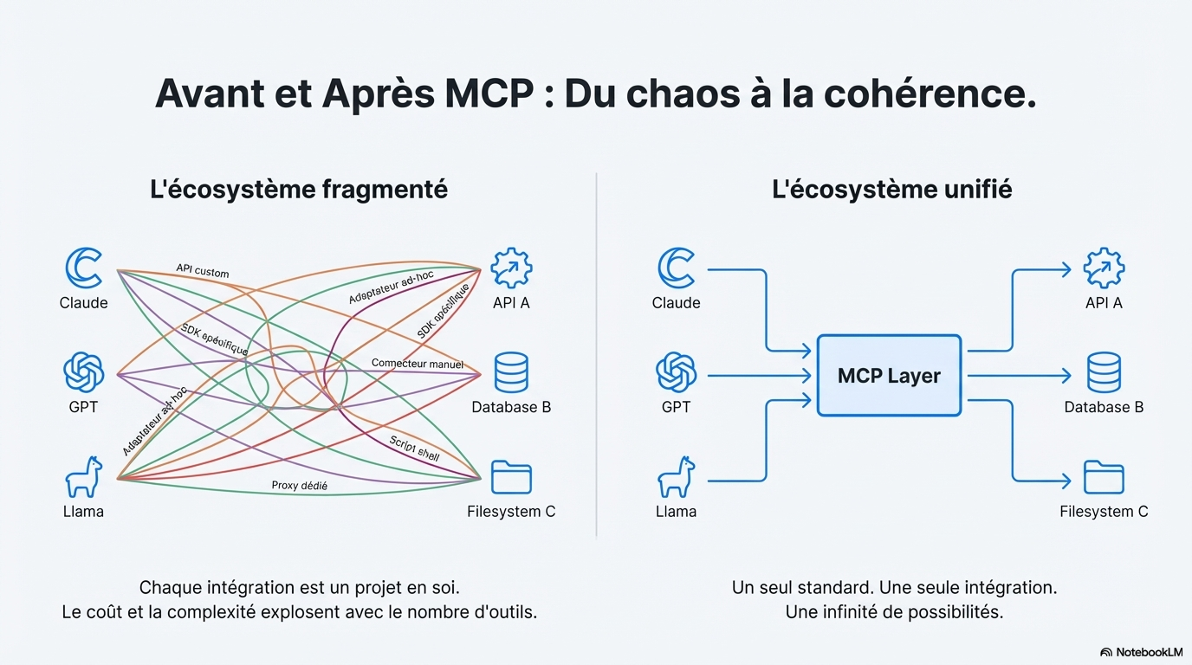
Page 3

Slide 4
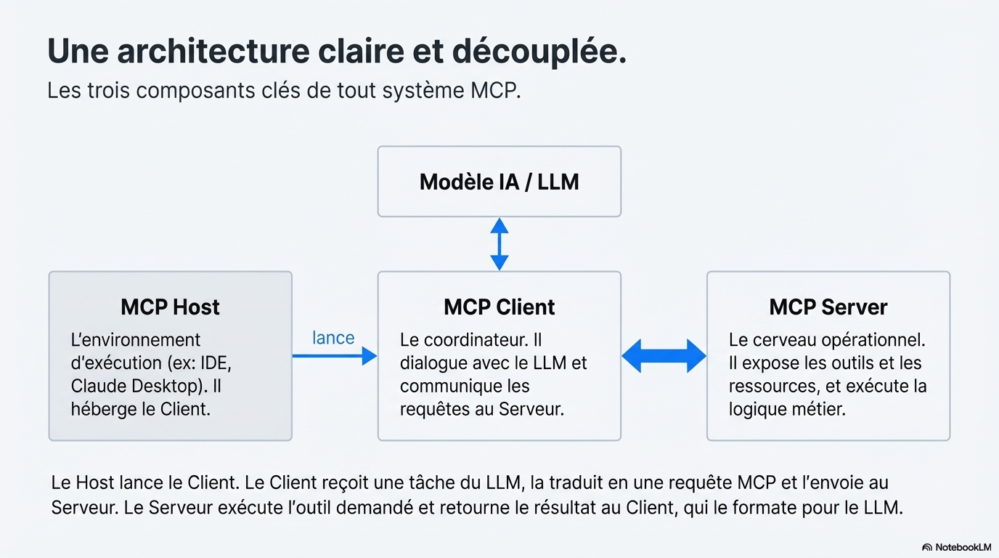
Page 4

Slide 5
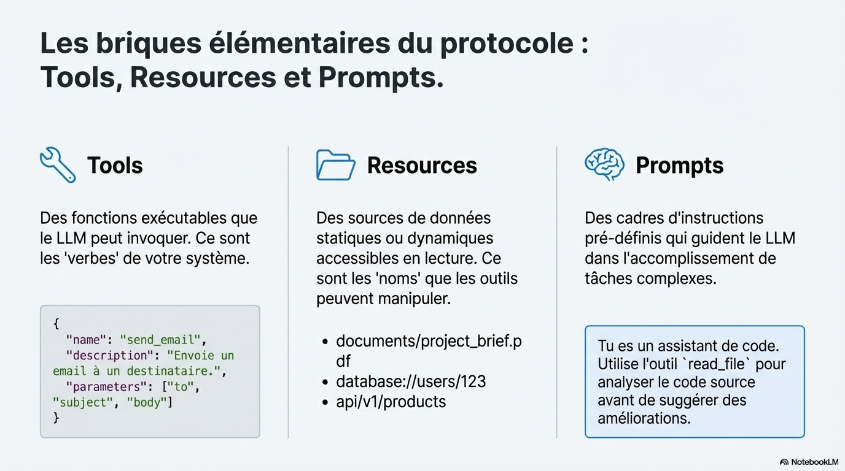
Page 5

Slide 6
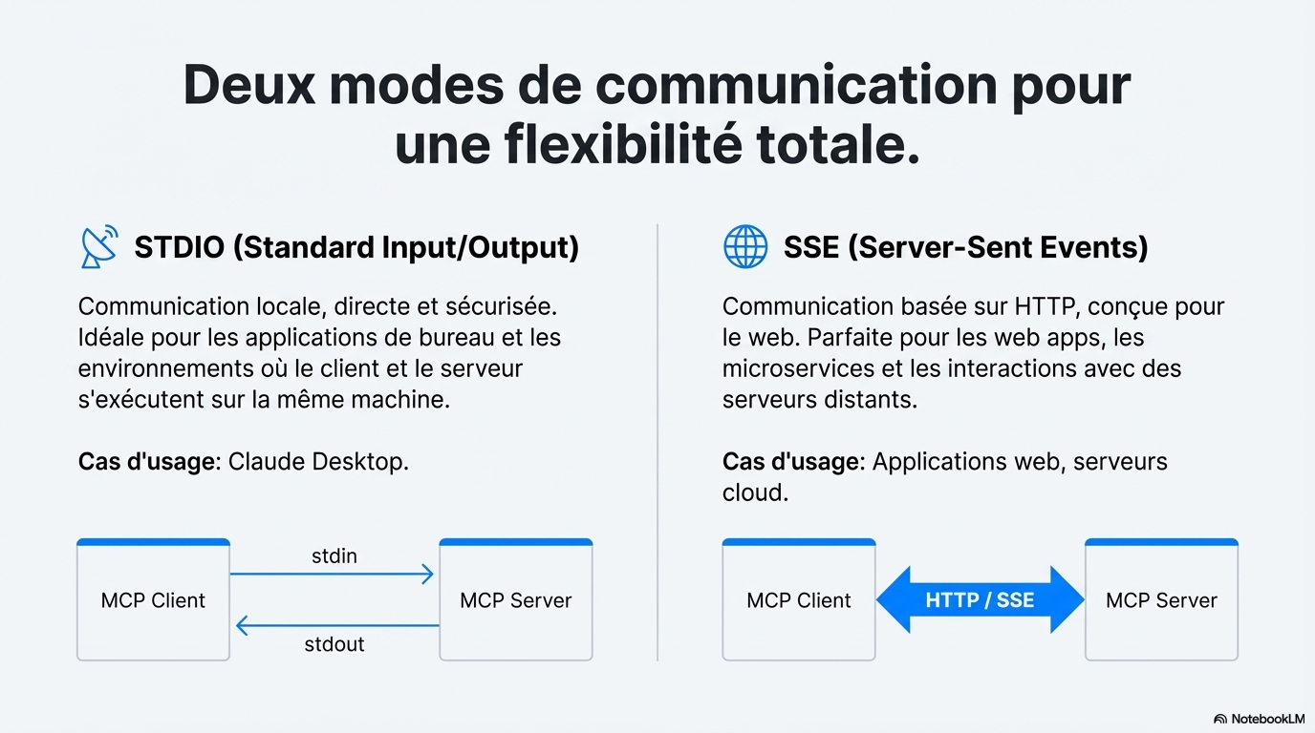
Page 6

Slide 7
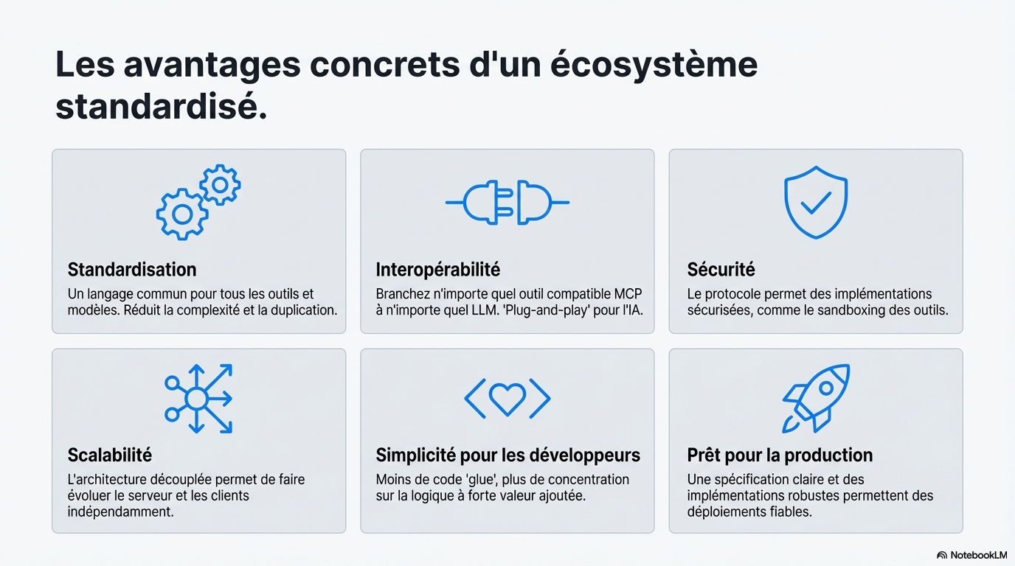
Page 7

Slide 8

Page 8

Slide 9
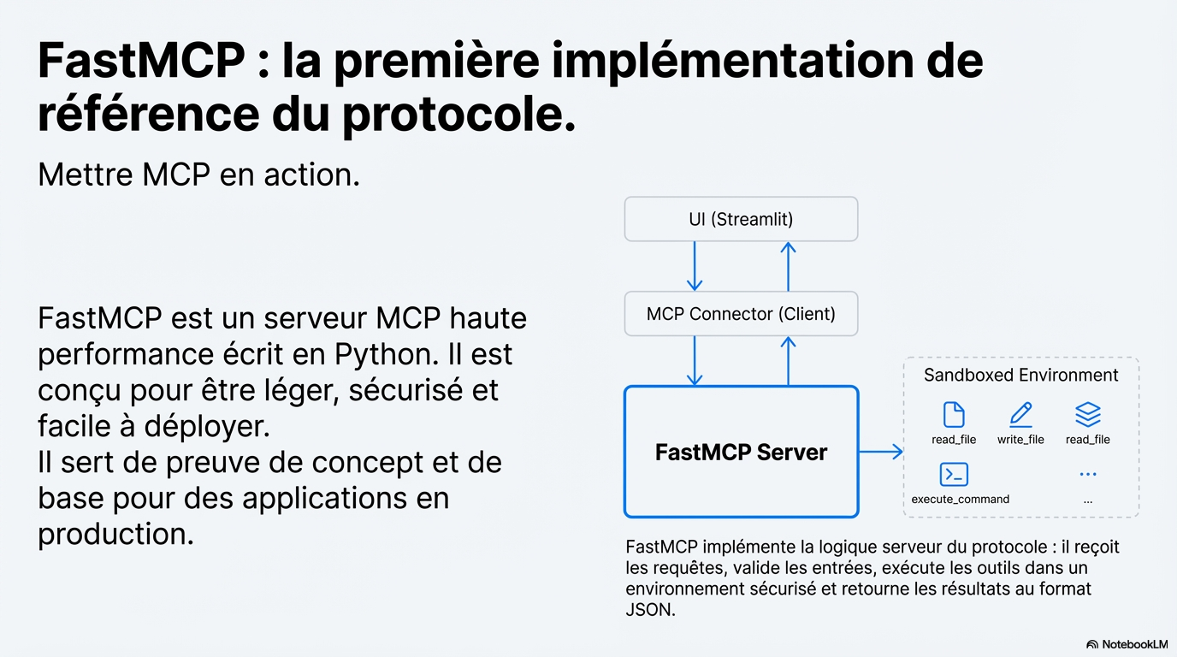
Page 9

Slide 10
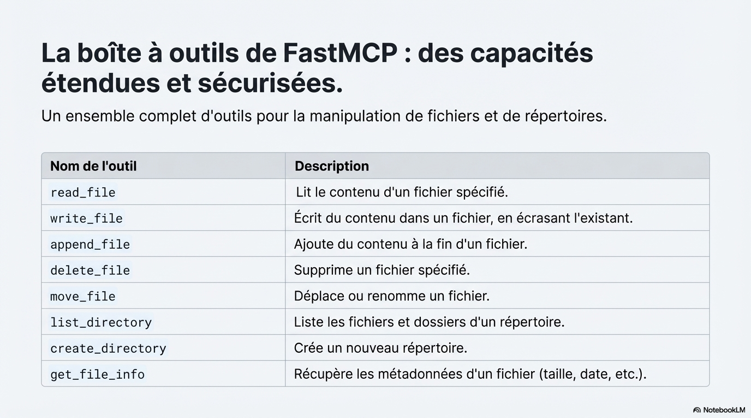
Page 10

Slide 11
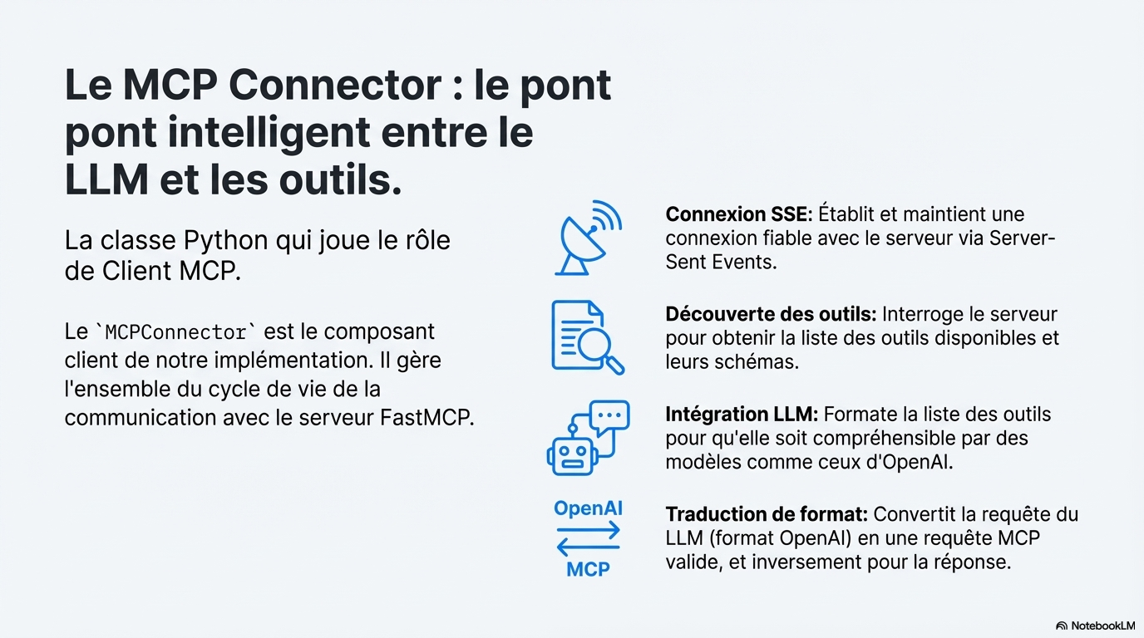
Page 11

Slide 12
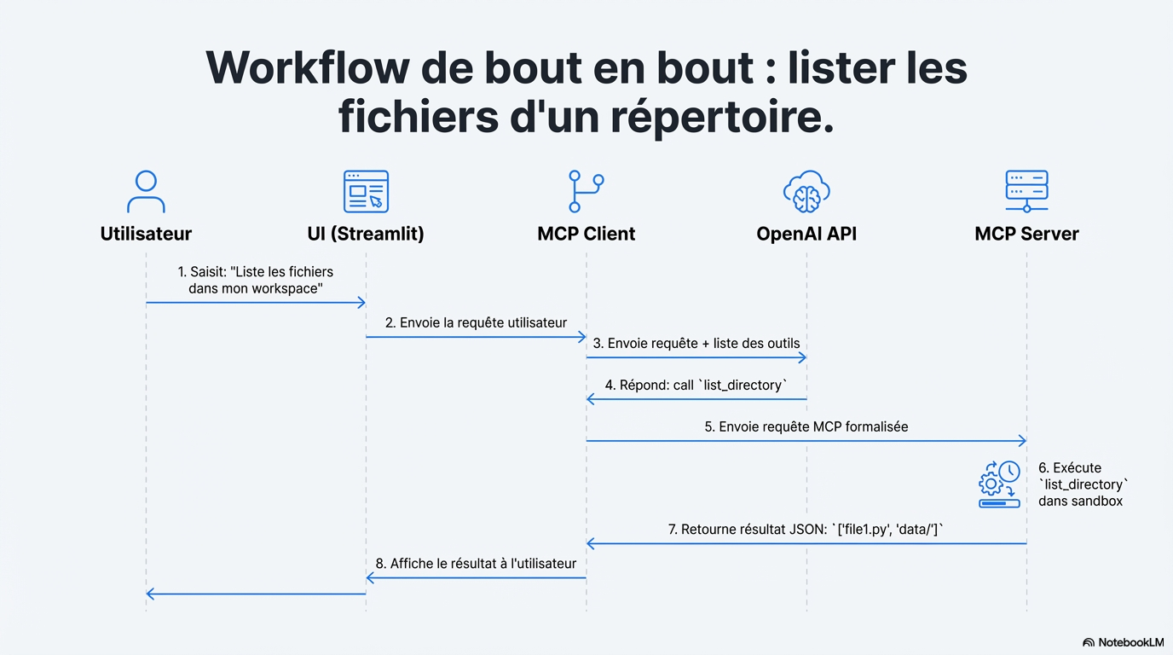
Page 12

Slide 13
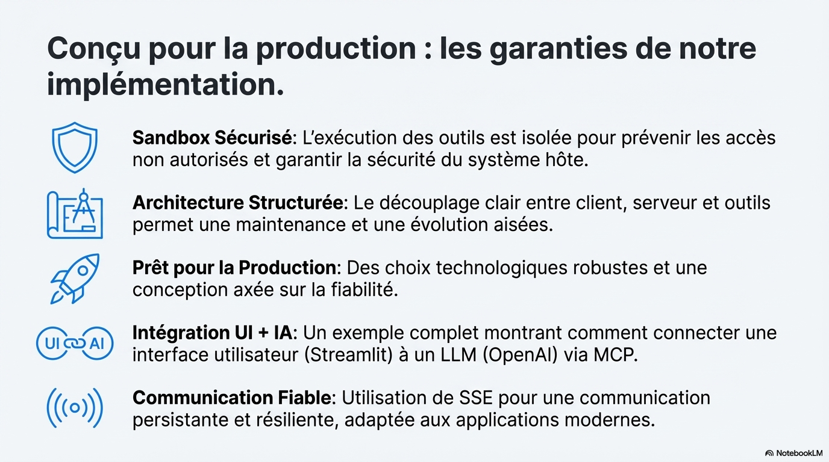
Page 13

Slide 14



https://github.com/chakorabdellatif/filesystem-mcp-with-FastMCP-server.git
Page 14

